Slide 1
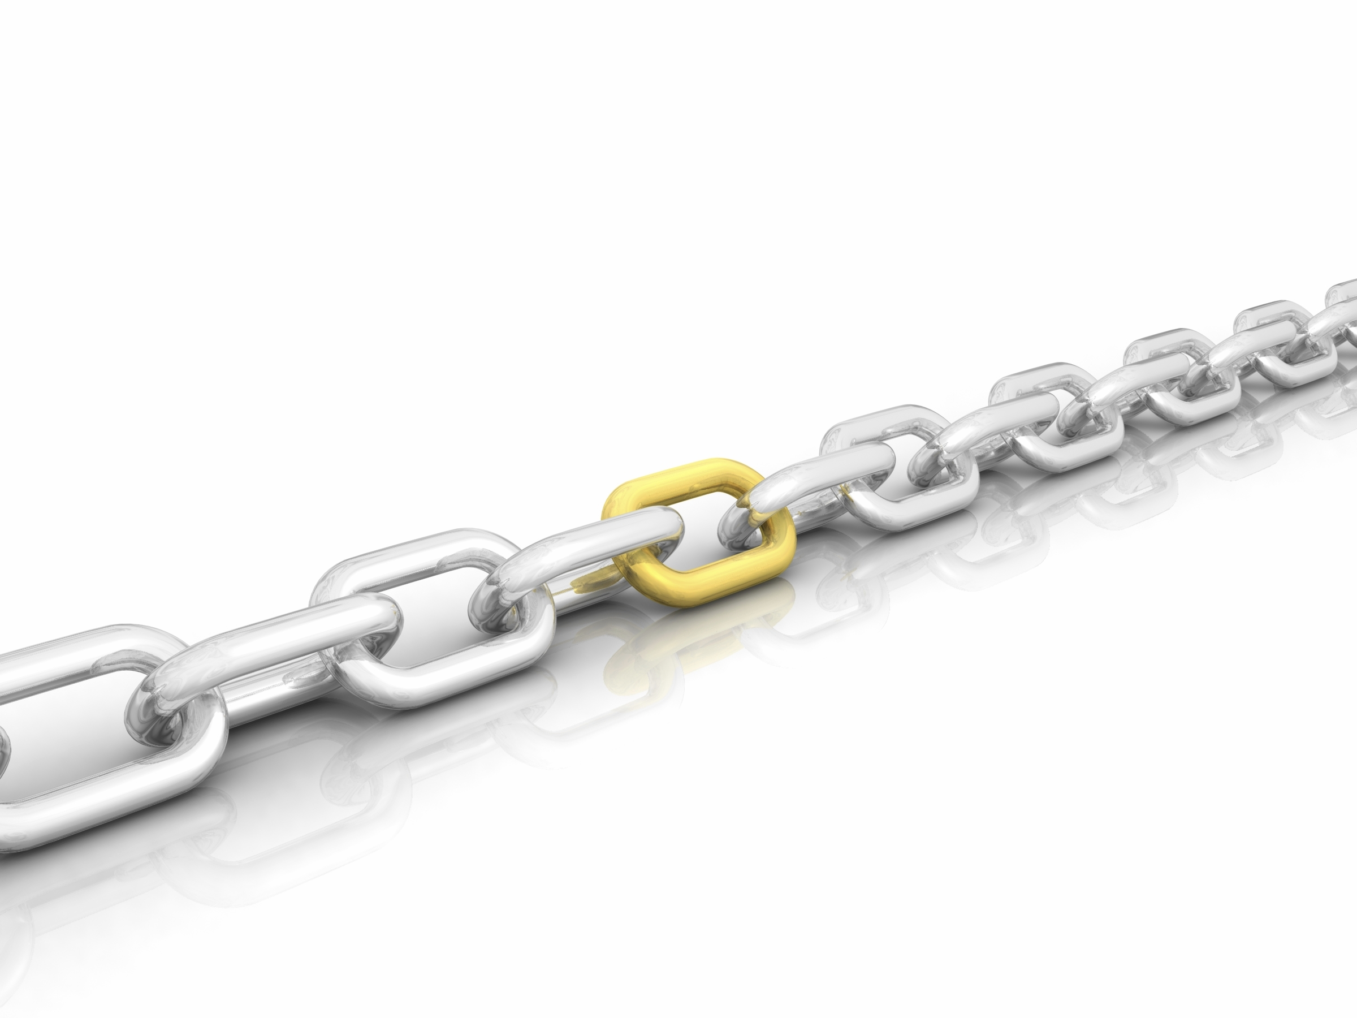
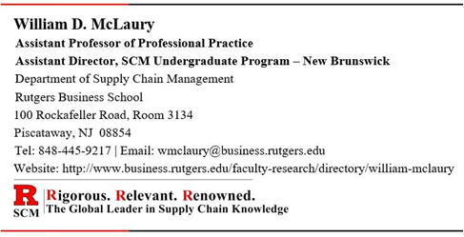
Supply Chain
Management
Introduction to Supply Chain Management

Slide 2
What is a Supply Chain?
Any organization offering a product or a service has a supply chain.
Products and Services are created from materials, equipment, labor, time, money, and other resources.
Products and services need suppliers, manufacturers, and customers; all of which make up a supply chain.
A supply chain can be very simple or it may be very complex.
Supply chains exist in organizations that are:
Large or Small
Public or Private
For-Profit or Not-for-Profit
Everyone in this room is part of multiple supply chains . . . whether you are consciously aware of it or not.
You may work for a supplier, a manufacturer, or a logistics provider . . .
You are most certainly on the demand side as a customer/consumer.

Slide 3
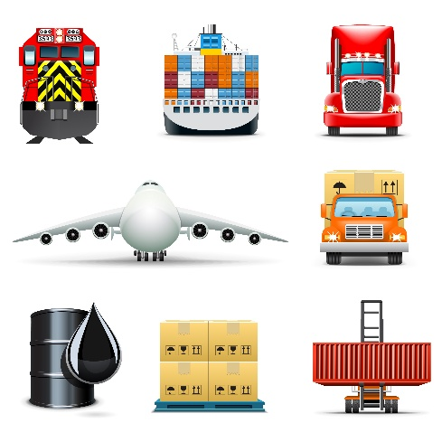
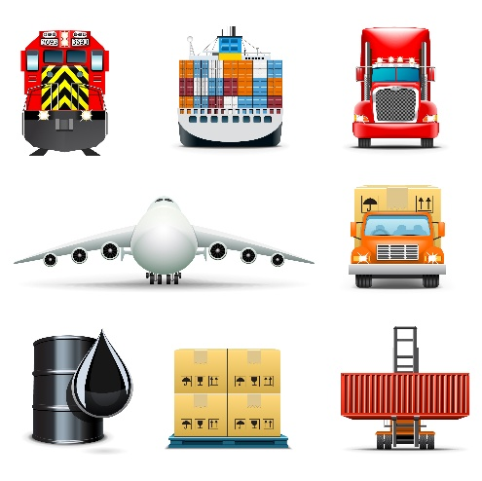



What is a Supply Chain? (continued)
Suppliers
Manufacturer
(Your Company)
Customers
Finished Product Manufacturer
Raw Material
Suppliers
(Tier 3)
Intermediate
Suppliers
(Tier 2)
Finished Material
Suppliers
(Tier 1)
Internal
Internal
Internal
Wholesaler &
Distributor
Customers
(Tier 1)
Retail
Customers
(Tier 2)
Consumers
(Tier 3)
Internal
Internal
External
External
External
Inbound Transportation
Outbound Transportation
Truck
Rail
Air
Pipeline
Water
A supply chain consists of the flow of materials and products from:
Raw Material Suppliers . . . to
Intermediate Suppliers . . . to
Finished Material Suppliers . . . to
Finished Product Manufacturers . . . to
Wholesalers and Distributors . . . to
Retailers and Consumers
“Nodes” or “Links” in the supply chain

Slide 4
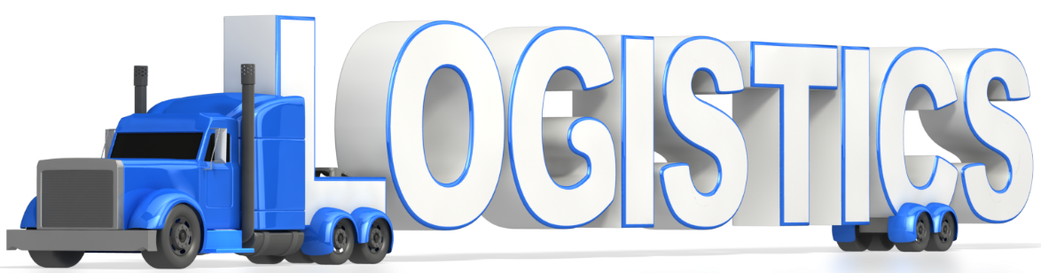
What is a Supply Chain? (continued)
Nodes or links in the supply chain are connected by
Warehousing (i.e., storage activities)
Transportation (i.e., movement activities).
Logistics is that part of supply chain management that plans, implements, and controls the flow and storage of goods, from point of origin to point of consumption.

Slide 5
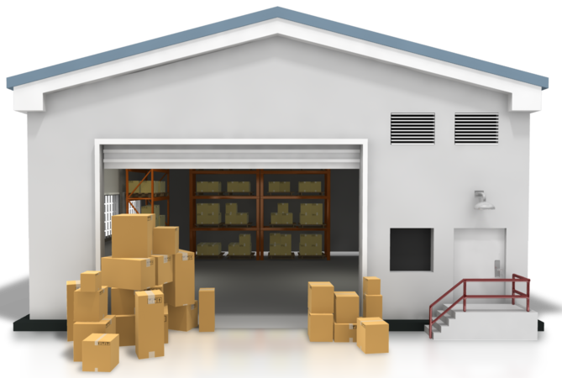
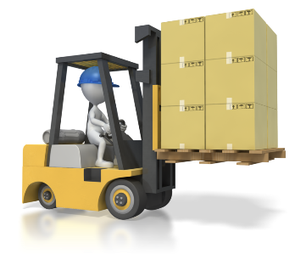
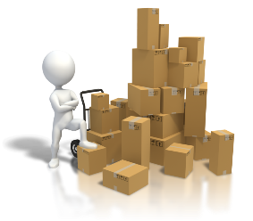
Warehousing
Warehouse: Facility that allows a company to store materials and finished products.
(Short-term or Long-term)
And . . .
Warehousing: Function that allows a company to receive, store, withdraw, package, and ship items to a manufacturing location, or finished products to a customer

Slide 6
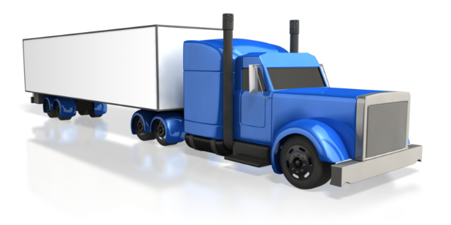
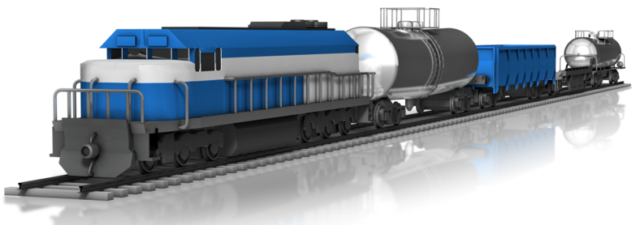
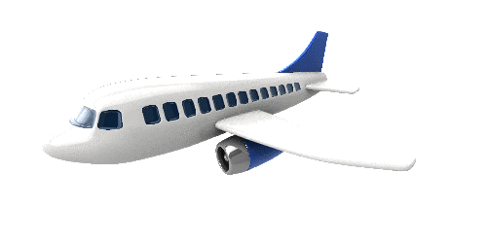
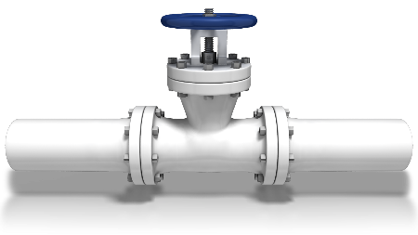

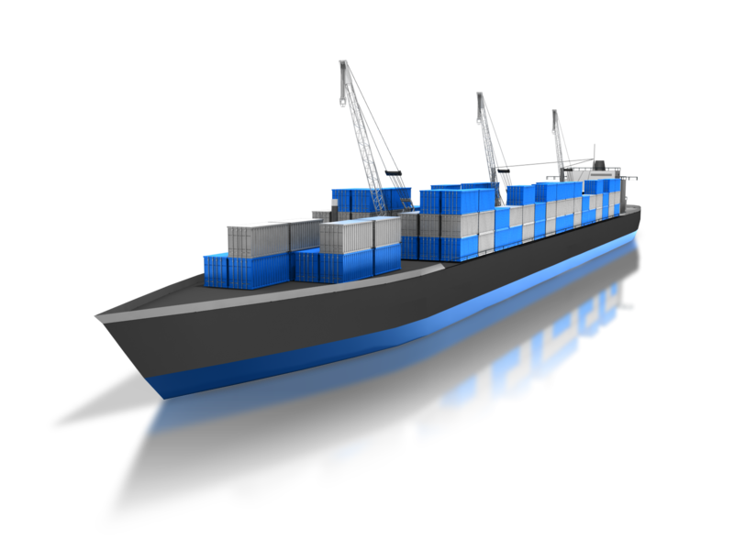
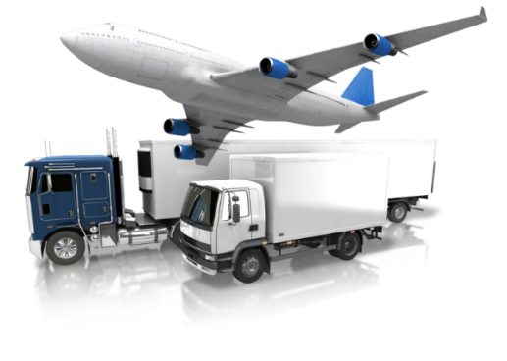
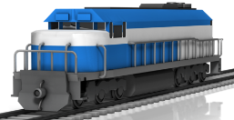
Transportation
“Mode” refers to the way in which goods are transported.
“Carrier” refers to the company that transports the goods
Truck
Rail
Air
Pipeline
Water
Ocean/Deep Water
Intracoastal
Inland Waterways
Intermodal = using a combination of any of the other modes of transportation for a single shipment.

Slide 7
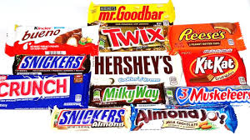
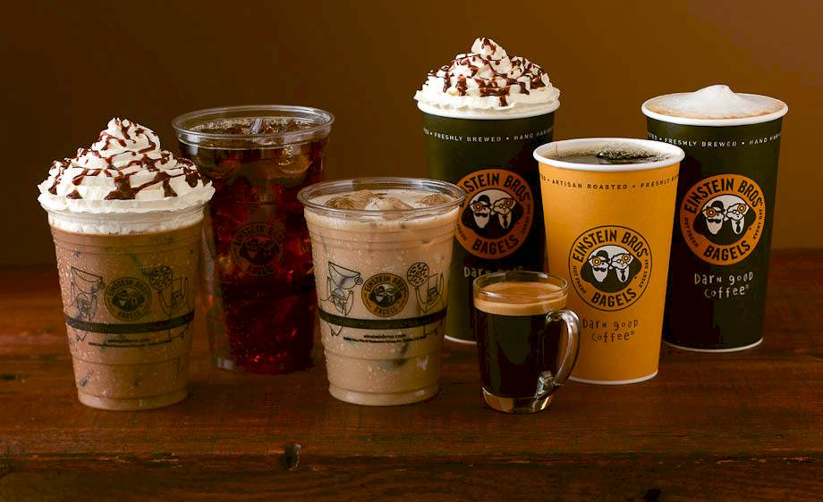
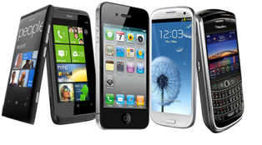
Products that you might buy – have a supply chain
Candy Bar
Soda Pop
Coffee drink
Fast food
Cell phone
Laptop computer
Clothes
Ear buds
What is your favorite Candy Bar?
Do you know what goes into making it?
How about your favorite coffee drink?
Or your cell phone?

Slide 8
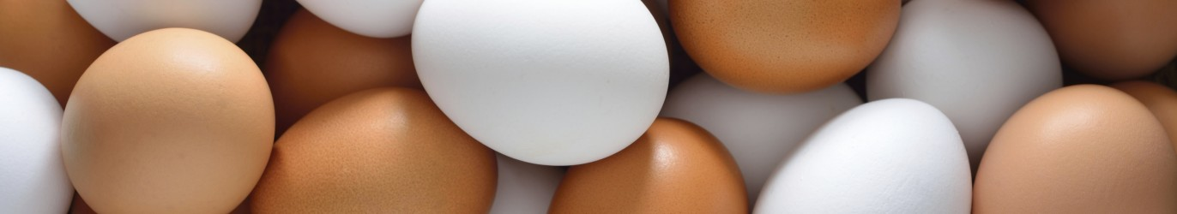
Supply Chain Discussion
Watch the following video carefully [as it goes by quickly]
Think about the images you are seeing in the video
At the end we will discuss what you observed:
Video: “Boiling an egg isn’t as simple as just boiling an egg”
https://vimeo.com/201651238
(1 minute)
Why is boiling an egg not just as simple as boiling an egg?
Did you see any elements of a “supply chain”? What were they?

Slide 9
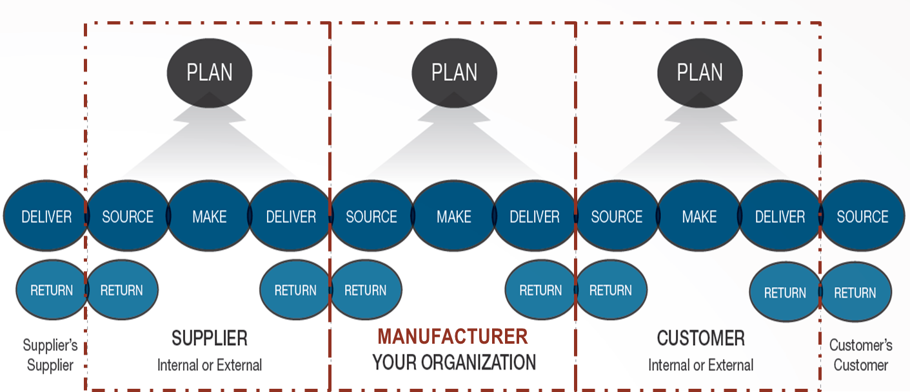
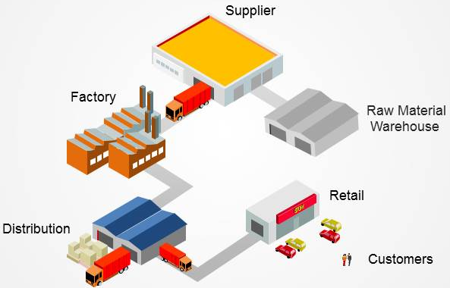
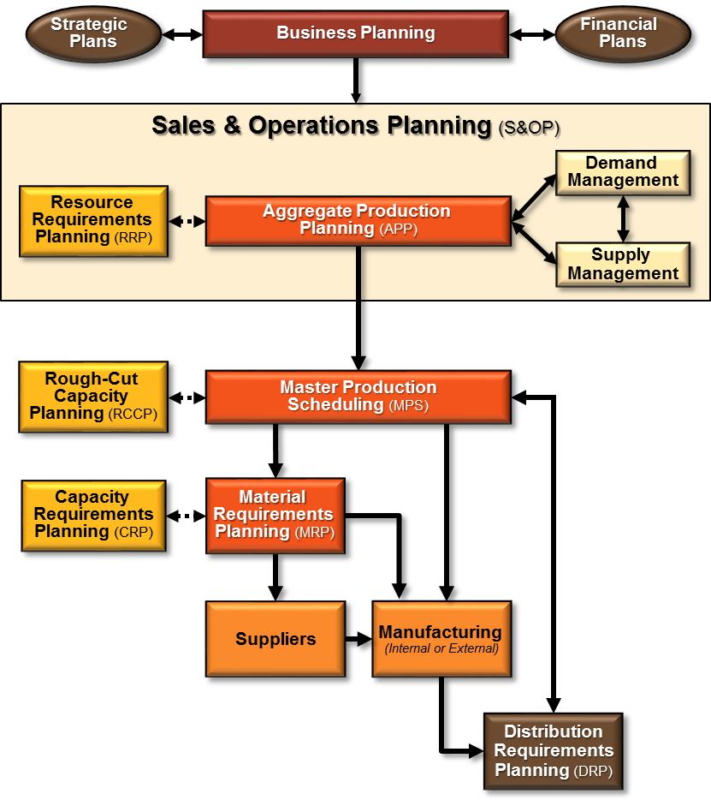
Supply Chain Management
Integrates all partners within the end-to-end supply chain
Starts with understanding the flow
Is conducted thru defined processes

Slide 10
Supply Chain Management
Let’s look at a general supply chain flow diagram
. . . and then a few examples of the supply chain for some familiar products.
Starts with understanding the flow

Slide 11
General Supply Chain Flow Diagram
Information Flow
Integrated through Information and Planning.
Product & Service Flow
Connected by Transportation and Storage Activities
Payment Flow
Suppliers
Manufacturer
Customers
Retailer
Supplier
Intermediate Supplier
Wholesaler or Distributor
Supplier
Manufacturer
(Finished Product)
Retailer
Consumers
Supplier
Retailer
Intermediate Supplier
Wholesaler or Distributor
Supplier
Transportation Activities
Retailer
Air
Rail
Water
Truck
Pipeline
Returns Flow

Slide 12
Supply Chain Flow
Normal supply chain flow of materials and products
Suppliers
Customers
Retailer
Supplier
Intermediate Supplier
Wholesaler or Distributor
Supplier
Manufacturer
(Finished Product)
Retailer
Consumers
Supplier
Retailer
Intermediate Supplier
Wholesaler or Distributor
Supplier
Retailer

Slide 13
Supply Chain Disruption
1
Scenario: A supplier has a problem and cannot deliver a key material to the manufacturer as planned (i.e., a supply disruption).
Suppliers
Customers
Retailer
Supplier
Intermediate Supplier
Wholesaler or Distributor
Supplier
Supply
Disruption
Manufacturer
(Finished Product)
Retailer
Consumers
Supplier
Retailer
Intermediate Supplier
Wholesaler or Distributor
Supplier
Retailer

Slide 14
Supply Chain Disruption
2
Scenario: The manufacturer cannot continue production of the finished product due to the material shortage, and therefore, cannot ship finished product out to customers against their open orders (this is knows as a “backorder”).
Suppliers
Customers
Retailer
Supplier
Intermediate Supplier
Wholesaler or Distributor
Supplier
Supply
Disruption
Manufacturer
(Finished Product)
Retailer
Consumers
Backorder
Supplier
Retailer
Intermediate Supplier
Wholesaler or Distributor
Supplier
Retailer
Other suppliers keep supplying materials to the manufacturer
Customers keep shipping the finished product inventory that they have until it is depleted

Slide 15
Supply Chain Disruption
3
Scenario: The manufacturer temporarily stops all suppliers from supplying materials. No inventory available throughout the distribution channels in the market (this is known as a “stockout”).
Suppliers
All supply chain nodes are interconnected and a disruption with one may impact all
Customers
Retailer
Supplier
Intermediate Supplier
Wholesaler or Distributor
Supplier
Supply
Disruption
Manufacturer
(Finished Product)
Retailer
Market
Stockout
Disruption Impacts
All Customers
Consumers
Disruption
Impacts
All
Suppliers
Supplier
Retailer
Intermediate Supplier
Wholesaler or Distributor
Supplier
The supply chain is only as strong as its weakest link
Retailer
“Upstream” supply chain is disrupted
“Downstream” supply chain is disrupted

Slide 16

Supply Chain Management in the Service Industry
It is not just products . . . services have a supply chain as well.
Service firms offer intangible products, meaning products that cannot be physically touched.
What customers are actually paying for in the service industry is the labor and the intellectual property of the service provider.
While the service itself is not tangible, it likely involves use of or work on a tangible item.
For example, we do not pay a dry cleaner for a shirt; instead, we provide our own shirt and pay the dry cleaner for the service of cleaning the shirt.

Slide 17
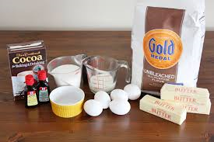
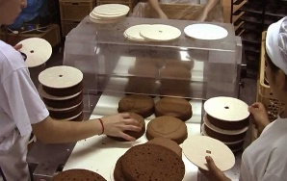
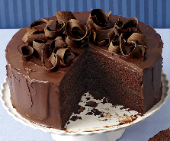
What is Supply Chain Management?
People may think of supply chain management as simply managing the steps involved in the production of a product
Materials (ingredients)
Manufacture or Assemble
Finished Product
+
=
. . . you buy some materials, and manufacture or assemble them step-by-step into a product, that you then sell to a customer . . .

Slide 18
Supply Chain Management is . . .
. . . NOT just the steps necessary to produce a product
. . . NOT just a chain of businesses
. . . NOT just a new name for Purchasing or for Production Operations
. . . NOT just a synonym for Logistics
Supply Chain Management is the way business gets done

Slide 19
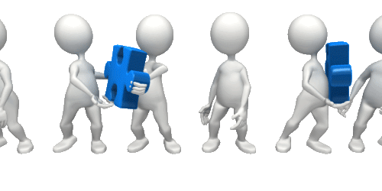
Supply Chain Management is highly Relational !
. . . the coordination of a network of otherwise independent organizations (i.e., trading partners) all involved in creating a desired product or service, and moving it from suppliers through manufacturing, and out to customers, when and where they want it.

Slide 20
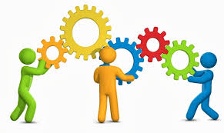
Supply Chain Management
Delivers value by managing the processes of all of those independent trading partners . . .
. . . so that they collaborate with one another in an efficient, effective, and cost conscious way.

Slide 21
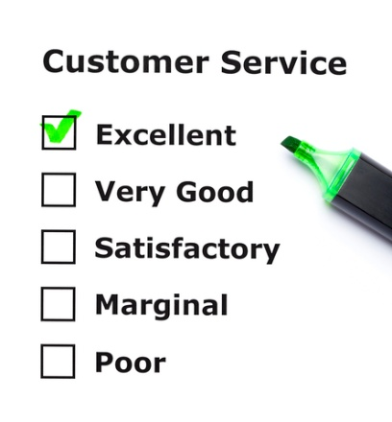
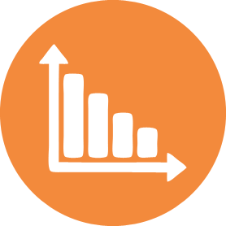
Importance of Supply Chain Management
The goal of Supply Chain Management is to:
Increase Customer Service
** while simultaneously **
Reducing both:
Inventory Investment and
Operating Expenses (i.e., costs)
Inventory & Expenses
Time
This is much harder to do than it might seem since these goals can be in conflict with one another
In line with this goal, the two main reasons that firms implement Supply Chain Management are to:
achieve cost savings
better coordinate resources

Slide 22
Supply Chain Management
Integrates all partners within the end-to-end supply chain
Starts with understanding the flow
Is conducted thru defined processes

Slide 23
Supply Chain Management
Integrates all partners within the end-to-end supply chain
Next let’s look at how the supply chain is integrated from end-to-end

Slide 24
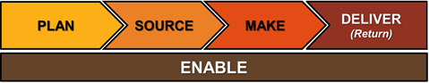
End-to-End Supply Chain Management
Supply Chain Operations Research (SCOR) Model
Supply chains are generally described as spanning from end-to-end, i.e., from your suppliers-suppliers on one end, through your internal operations, and out to your customers-customers on the other end.
All supply chains follow the basic model:
PLAN
PLAN
PLAN
DELIVER
SOURCE
MAKE
DELIVER
SOURCE
MAKE
DELIVER
SOURCE
MAKE
DELIVER
SOURCE
RETURN
RETURN
RETURN
RETURN
RETURN
RETURN
RETURN
RETURN
SUPPLIER
Internal or External
MANUFACTURER
YOUR ORGANIZATION
CUSTOMER
Internal or External
Customer’s
Customers
Supplier’s
Suppliers
Most supply chains are Enabled through various types of processes and technologies.
Source: SCOR Model

Slide 25
SCOR Model: PLAN
PLAN
PLAN
PLAN
DELIVER
SOURCE
MAKE
DELIVER
SOURCE
MAKE
DELIVER
SOURCE
MAKE
DELIVER
SOURCE
RETURN
RETURN
RETURN
RETURN
RETURN
RETURN
RETURN
RETURN
Supplier’s
Suppliers
SUPPLIER
Internal or External
MANUFACTURER
YOUR ORGANIZATION
CUSTOMER
Internal or External
Customer’s
Customers
Planning establishes the parameters within which the supply chain will operate.
Planning includes the determination of marketing and distribution channels, promotions, quantities, timing, inventory and replenishment policies, and production policies.

Slide 26
SCOR Model: SOURCE
PLAN
PLAN
PLAN
DELIVER
SOURCE
MAKE
DELIVER
SOURCE
MAKE
DELIVER
SOURCE
MAKE
DELIVER
SOURCE
RETURN
RETURN
RETURN
RETURN
RETURN
RETURN
RETURN
RETURN
Supplier’s
Suppliers
SUPPLIER
Internal or External
MANUFACTURER
YOUR ORGANIZATION
CUSTOMER
Internal or External
Customer’s
Customers
Sourcing is the process of identifying the suppliers that provide the materials and services needed for the supply chain to deliver the finished product(s) desired by the customer(s).
This phase involves not only identifying reliable suppliers but also building a strong relationship with those suppliers.
Supply chain managers must also develop pricing, shipping, delivery, and payment processes with suppliers and create metrics for monitoring and improving the performance

Slide 27
SCOR Model: MAKE
PLAN
PLAN
PLAN
DELIVER
SOURCE
MAKE
DELIVER
SOURCE
MAKE
DELIVER
SOURCE
MAKE
DELIVER
SOURCE
RETURN
RETURN
RETURN
RETURN
RETURN
RETURN
RETURN
RETURN
Supplier’s
Suppliers
SUPPLIER
Internal or External
MANUFACTURER
YOUR ORGANIZATION
CUSTOMER
Internal or External
Customer’s
Customers
Make or manufacturing is the series of operations performed to convert materials into a finished product.
Finished product is manufactured, tested, packaged, and scheduled for delivery.
Quality management is an important aspect of the manufacturing process.
This is the most metric-intensive portion of the supply chain, where companies are able to measure quality levels, production output, and worker productivity.

Slide 28
SCOR Model: DELIVER
PLAN
PLAN
PLAN
DELIVER
SOURCE
MAKE
DELIVER
SOURCE
MAKE
DELIVER
SOURCE
MAKE
DELIVER
SOURCE
RETURN
RETURN
RETURN
RETURN
RETURN
RETURN
RETURN
RETURN
Supplier’s
Suppliers
SUPPLIER
Internal or External
MANUFACTURER
YOUR ORGANIZATION
CUSTOMER
Internal or External
Customer’s
Customers
Also known as the Logistics phase, this is the part of supply chain management that oversees the planning and execution of the forward flow of goods and related information between various points in the supply chain to meet customer requirements.
Where companies coordinate the receipt of orders from customers, develop a network of warehouses, pick carriers to transport products to customers, and set up an invoicing system to receive payments, among other aspects.

Slide 29
SCOR Model: RETURN
PLAN
PLAN
PLAN
DELIVER
SOURCE
MAKE
DELIVER
SOURCE
MAKE
DELIVER
SOURCE
MAKE
DELIVER
SOURCE
RETURN
RETURN
RETURN
RETURN
RETURN
RETURN
RETURN
RETURN
Supplier’s
Suppliers
SUPPLIER
Internal or External
MANUFACTURER
YOUR ORGANIZATION
CUSTOMER
Internal or External
Customer’s
Customers
Also known as Reverse Logistics, this is the part of supply chain management that deals with planning and controlling the process of moving goods specifically from the point of consumption back to the point of origin for repair, reclamation, remanufacture, recycling, or disposal.
As this process quite literally goes against the normal outbound flow of products to the market, supply chain managers have to create a responsive and flexible network for receiving defective and excess products back from their customers and supporting customers who have questions and problems

Slide 30
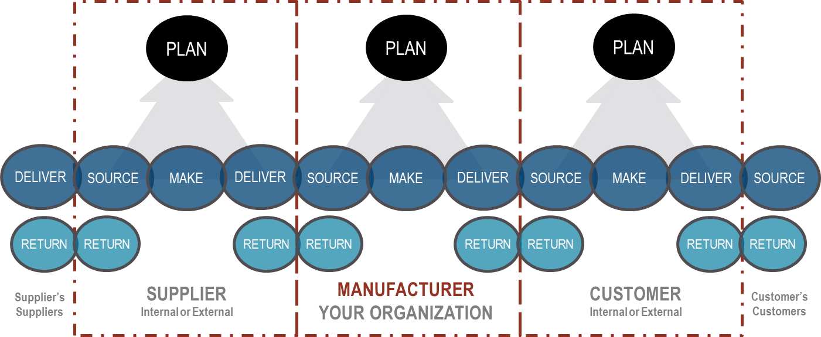
SCOR Model: ENABLE
An additional aspect of the model is referred to as “Enable.”
Enabling processes facilitate a company’s ability to manage the supply chain and are spread throughout every stage.
In other words, we want to enable our capabilities as we plan, source, make, and deliver (and return).
This is not a stage that occurs sequentially after all of the others.
Enabling processes include elements such as
Supply Chain Systems and Network Operations
Systems Configuration Control
Interfaces
Gateways
Database Administration
Electronic Data Interchange (EDI)
Telecommunications Services
Performance Measurement
Contract Management
Business Rules
Standards
Training and Education
ENABLE

Slide 31
Course Alignment with the SCOR Model
These are the chapters in this course that we will follow in sequence aligned to the SCOR Model
Deliver
Plan
Source
Make
Enable
Return
(covered only if time permits)
Introduction to Supply Chain Management | Purchasing Management | Operations Management (with Lean & Six Sigma) | Logistics: Warehousing, Transportation, & Reverse Logistics | Project Management
Forecasting & Demand Planning | Strategic Sourcing |  | Global Logistics & International Trade | Supply Chain Risk and Resiliency
Supply Chain Planning | Supplier Relationship Management |  | Customer Relationship Management | Performance Measurement
Inventory Management |  |  | Supply Chain Management in the Service Industry | Supply Chain Integration
1
5
8
9
13
2
6
10
14
3
7
11
15
4
12
16

Slide 32

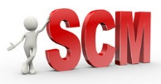
Origins and Evolution of Supply Chain Management
1980’s, 1990’s & 2000’s
Instead of focusing only internally, companies started to look beyond their “four walls” and incorporate their supply chain partners into their planning activities.
Intense global competition led U.S. manufacturers to adopt:
Supply Chain Management (SCM) - In the early 1980s, the term Supply Chain Management was coined by Dr. Wolfgang Partsch and his team at Booz, Allen & Hamilton

Slide 33

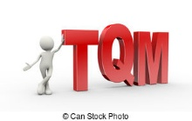
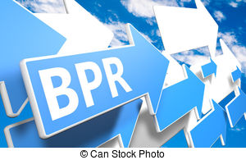
Origins and Evolution of Supply Chain Management
1980’s, 1990’s & 2000’s
(continued)
Just-in-Time is a philosophy of manufacturing based on the planned elimination of all waste and continuous productivity improvement.
Total Quality Management is a management approach to long-term success through customer satisfaction based on the participation of all members of an organization in improving processes, goods, services, and the culture in which they work. Everyone in the organization has to take ownership for quality.
Business Process Reengineering is a procedure that involves the fundamental rethinking and radical redesign of business processes to achieve dramatic organizational improvements in such critical measures of performance as cost, quality, service, and speed.

Slide 34
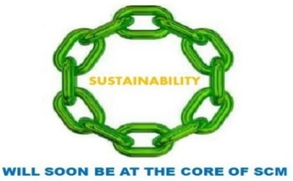
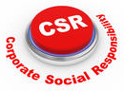
Origins and Evolution of Supply Chain Management
Today and Beyond
(continued)
Companies are focusing on their own core competencies, outsourcing those things are not their core competencies, using the expertise of their trading partners
Companies will also continue to focus on:
Building relationships
Sustainability
Corporate Social Responsibility (CSR)
Improving supply chain capabilities:
Increased use of Third-Party Logistics (3PLs) service providers
Integrating logistics internally and with external trading partners
Using transportation to facilitate rapid response

Slide 35
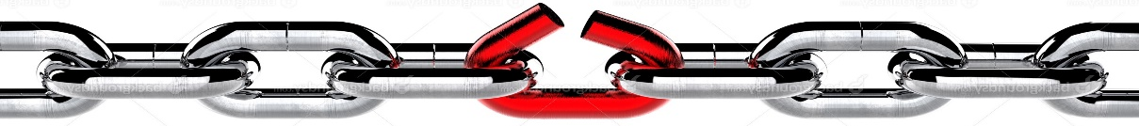
The Future of Supply Chain Management
Old paradigm – A company gained synergy as a vertically integrated firm encompassing the ownership and coordination of several supply chain activities.
Organizational cultures emphasized short-term, company focused performance.
New paradigm - A company in a supply chain focuses activities in its’ area of specialization and enters into voluntary and trust-based relationships with supplier and customer firms. “Outsourcing non-core competencies”
All participants in the supply chain benefit.
Boundaries are dynamic and extend from “the firm’s suppliers’ suppliers to its customers’ customers (i.e., “end-to-end”)
Supply chains also deal with reverse logistics to handle product returns, warranty repairs, and recycling.
What do we know about a chain? … It’s only as good as its’ weakest link

Slide 36
Push Business Model
Anticipatory Business Model
(used by 95% of companies)
Create Forecast
Create
Supply
Plan
Buy Materials to Produce Product(s)
Manufacture
Product(s)
Warehouse
Product(s)
Sell Product(s) to Customer
Deliver Product(s) to Customer
Push or Make-to-Stock: Producing stock on the basis of anticipated demand. Demand forecasting can be done via a variety of sophisticated techniques.
Advantages: If the manufacturer creates a good forecast and supply plan, the product is immediately available to ship to the customer on demand from the existing finished product inventory in the warehouse.
Manufacturers also have the opportunity to plan resources better or with more flexibility, and can maximize the utilization of resources at the lowest cost.
Disadvantages: High inventories (and capital tied up in inventory), dependency on forecasting, forecasting error creates non-value adding time, inefficiencies, obsolescence, shortages, and additional cost.

Slide 37
Pull Business Model
Responsive Business Model
(used by only 5% of companies)
Sell Product(s) to Customer
Create
Supply
Plan
Buy Materials to Produce Product(s)
Manufacture
Product(s)
Deliver Product(s) to Customer
Pull or Make-to-Order: Producing stock in response to actual demand
Advantages: High levels of customer service through responsiveness and flexibility to meet uncertain customer demand.
Pull models have short lead times, reduce dependency on forecasting, use short and flexible production runs, store very low inventories, reduce waste, provide opportunities for customization, and improve cash flow.
Disadvantages: Every order is basically a rush order, and any problems will lead to customer dissatisfaction.
Pull models are highly dependent on customer relationship. They have a reduced ability to take advantage of economies of scale. Fast, responsive, flexible, robust and integrated systems and processes are a must for this model to work. Resource issues will have a significant and immediate impact on throughput and customer satisfaction.

Slide 38
Supply Chain Management
Next we will look at the processes used to manage the supply chain
Is conducted thru defined processes

Slide 39
SCM Planning & Control Process
World class operational excellence begins with effective supply chain planning and control techniques which:
Provides a single set of numbers used to run the business.
Generates significant improvements in customer service, productivity, inventory and costs.
Measures of Success (Examples)
Customer Service
> 99% Line Item Fill Rate
Demand Plan Conformance
> 80% Forecast Accuracy
Supply Plan Conformance
> 95% On-Time Delivery
Inventory Plan Conformance
< 4.0 Month on Hand Total Inventory
Cost of Goods Sold (COGS)
< 15% Cost of Goods Sold

Slide 40
Supply Chain Management Challenge
DEMAND
SUPPLY
TRAINING &
DEVELOPMENT
LEAD TIME
QUALITY
CONTROL
R&D
REQUIREMENTS
TRANSPORTATION
SUPPLIERS &
MATERIALS
INDEPENDENT
DEMAND
LABOR
SCHEDULED
MAINTENANCE
SAFETY
STOCK
MONEY
WAREHOUSE
STORAGE SPACE
SAMPLE
REQUIREMENTS
PRODUCTION &
INVENTORY
TRADE REQUIREMENTS
EQUIPMENT & FACILITIES
Customer
Service
Supply Chain Management
INVENTORY
“SHOCK ABSORBER”
FLEXIBILITY
“SHOCK ABSORBER”
Working Capital
(Inventory Investment)
Cost of Goods Sold
(Operating Expenses)

Slide 41
Benefits of Supply Chain Management
Improved customer service
Increased revenue
Lower costs
Better asset utilization
Adds customer value / retain customers
Minimize delays / shorter lead-times
Elimination of rush (unplanned) activities
Reduced uncertainty throughout the supply chain
Lower inventory levels throughout the supply chain
Ability to effectively respond to disruptions and conflicts
Value
for both internal
and
external customers

Slide 42
Who Benefits
Who benefits the most from supply chain management?
Firms with:
Large inventories
Large number of suppliers
Complex products and/or large number of products
Large purchasing budgets / expenditures
NOTE: That is NOT to say that smaller companies don’t benefit from supply chain management as well, just that larger companies with more suppliers and more complex product portfolios generally benefit more.

Slide 43
Breaking down Silos
https://www.youtube.com/watch?v=nwqROZPi_-0

